Slide 1

PROJECT- 1 California Housing Data Set -Manasi Shimpi

Slide 2
AIM: To Understand and analyse the Data Set using Appropriate Plots and Functions In this project I’m going to use python libraries like pandas , matplotlib , seaborn to address certain questions.

Slide 3
INTRODUCTION: The California Housing dataset consists of data collected from the California 1990 Census. The dataset has 20640 examples of block groups, each containing on average 1425,5 individuals living in a geographically compact area.

Slide 4
There are 10 different variables we used in this Data set. They are: 1.longitude : A measure of how far west a house is; a more negative value is farther west (Continuous) 2.latitude : A measure of how far north a house is; a higher value is farther north(Continuous) 3.housing Median Age : Median age of a house within a block (Discreate)or (Continuous) 4.TotalRooms : Total number of rooms within a block (Discreate) 5.TotalBedrooms :Total number of bedrooms within a block(Discreate) 6.population : Total number of people residing within a block(Discreate) 7.Households : Total number of households, a group of people residing within a home unit, for a block (Discreate) 8.MedianIncome : Median income for households within a block of houses (Continuous) 9.MedianHouseValue : Median house value for households within a block (Discreate) 10.ocean proximity : Location of the house with respect to ocean/sea(Nominal)

Slide 5
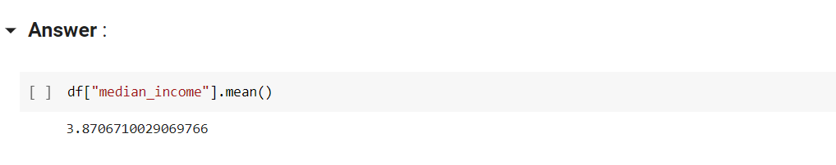
1. What is the average median income of the data set and check the distribution of data using appropriate plots? Please explain the distribution of the plot
Mean()

Slide 6
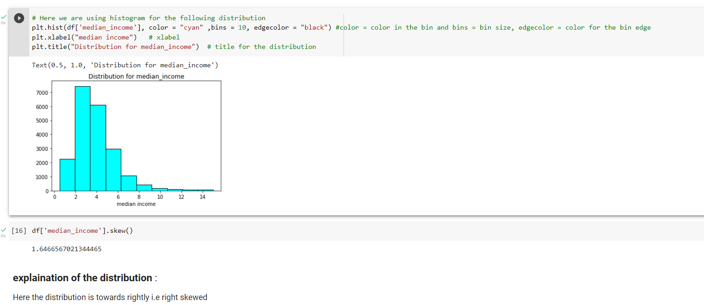
Distribution of the data :

Slide 7
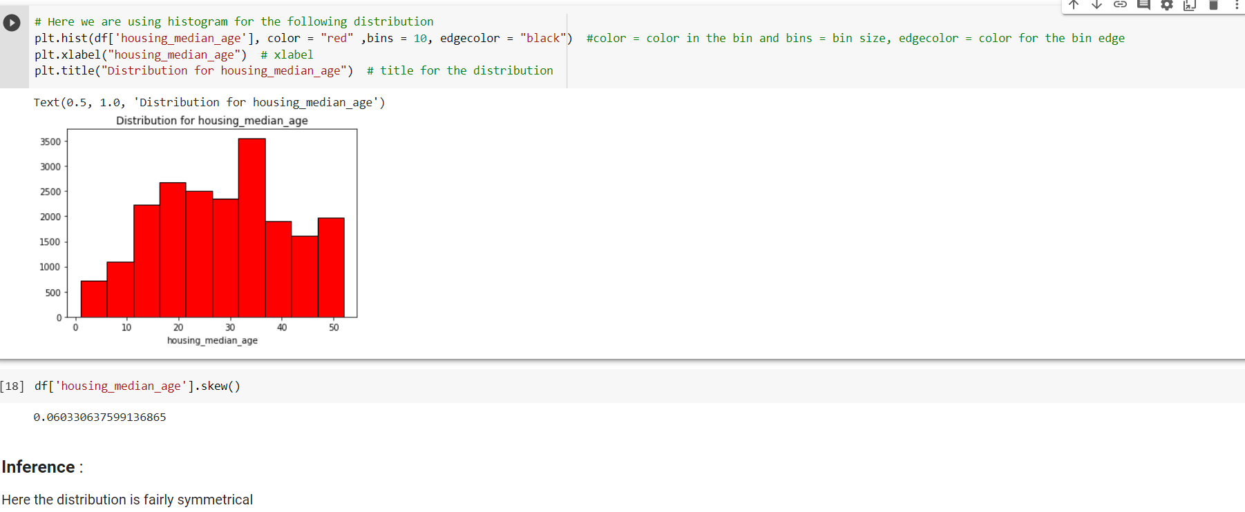
2.Draw an appropriate plot for housing_median_age and explain your observations.

Slide 8
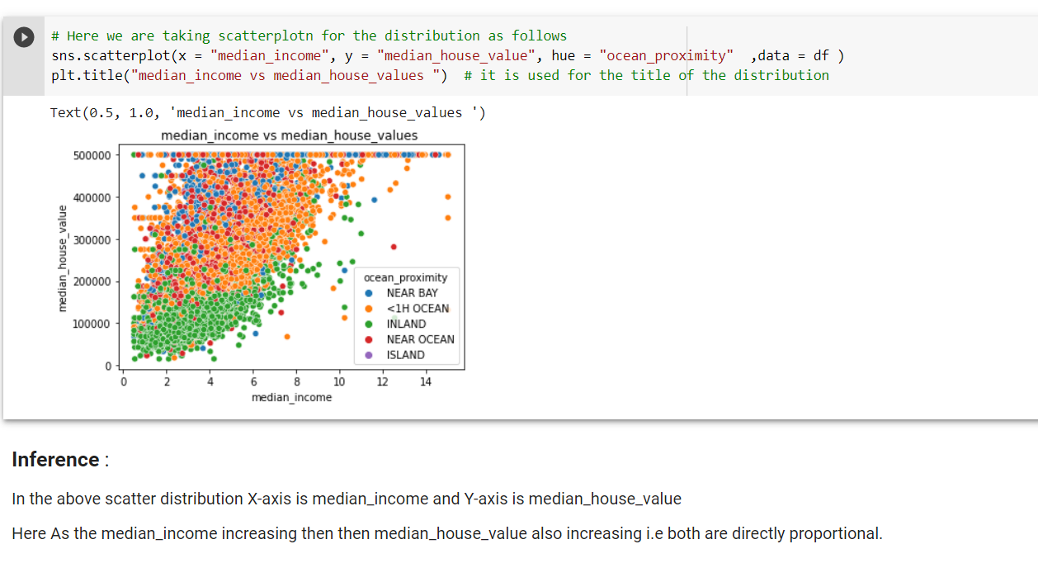
3.Show with the help of visualization , how median_income and median_house_values are related?

Slide 9
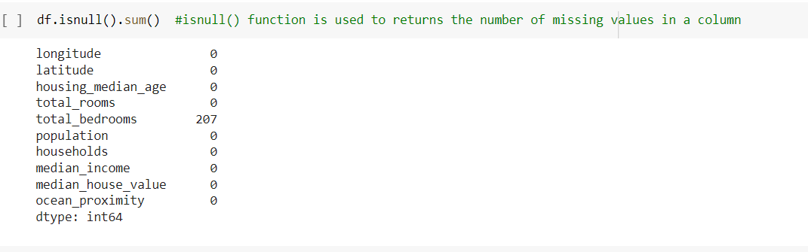
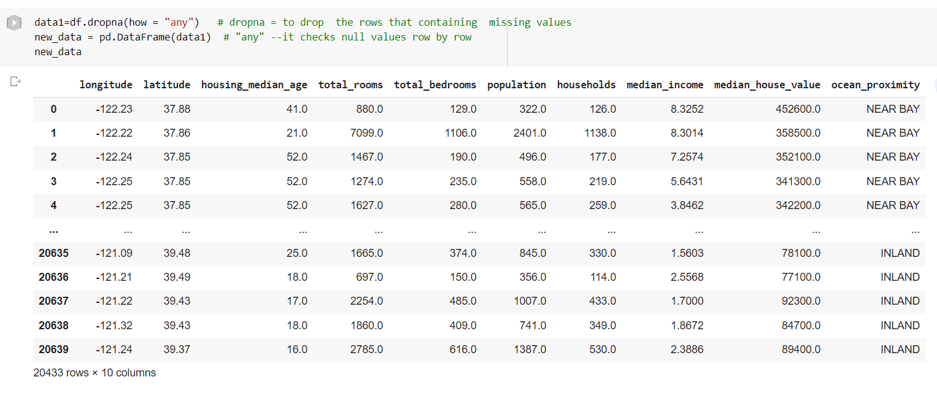
4. Create a data set by deleting the corresponding examples from the data set for which total_bedrooms are not available.
ISNULL( )
Returns the number of missing values in a column
dropna()
To drop the rows that containing missing values

Slide 10
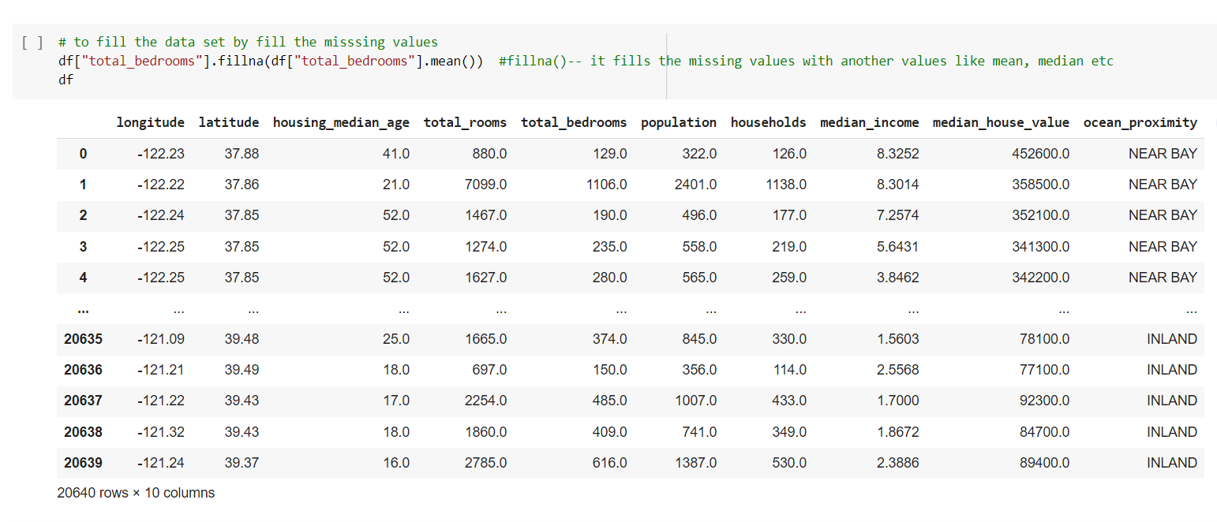
5.Create a data set by filling the missing data with the mean value of the total_bedrooms in the original data set.
fillna()
It fills the missing values with another values

Slide 11
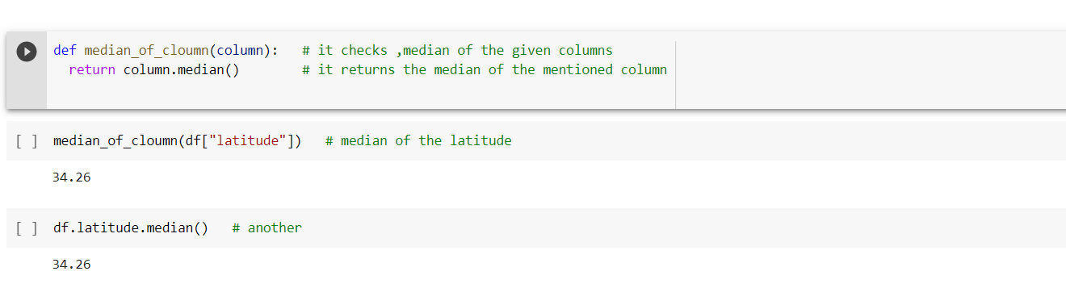
6.Write a programming construct to calculate the median value of the data set wherever required.

Slide 12
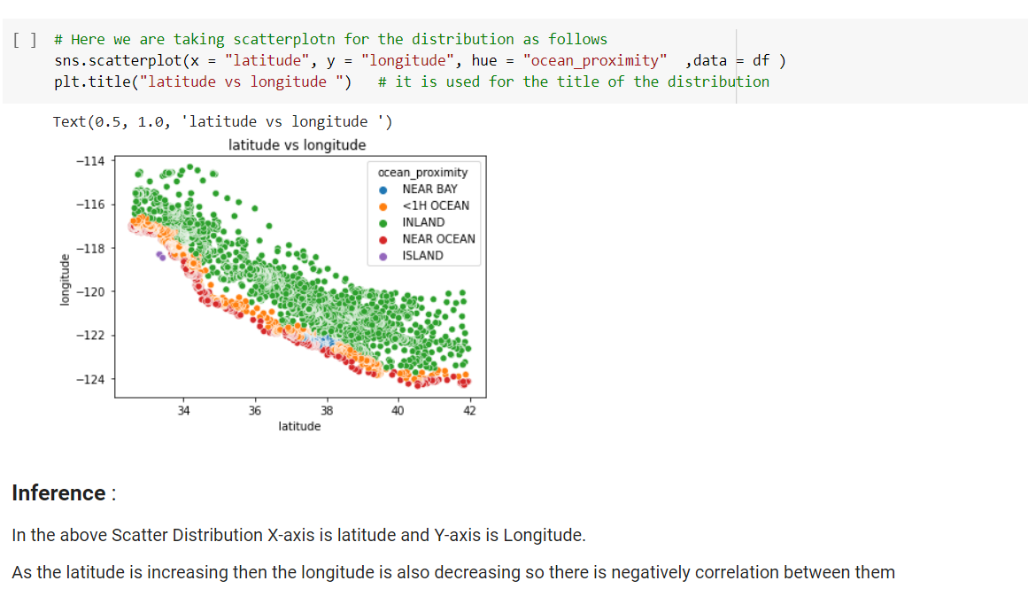
7.Plot latitude versus longitude and explain your observations.

Slide 13
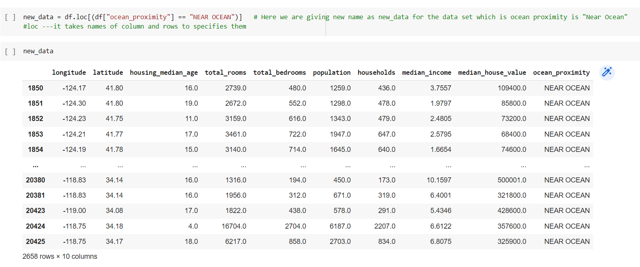
8.Create a data set for which the ocean_proximity is 'Near ocean'.
loc()
to pass the name of the row or column which we want to select

Slide 14
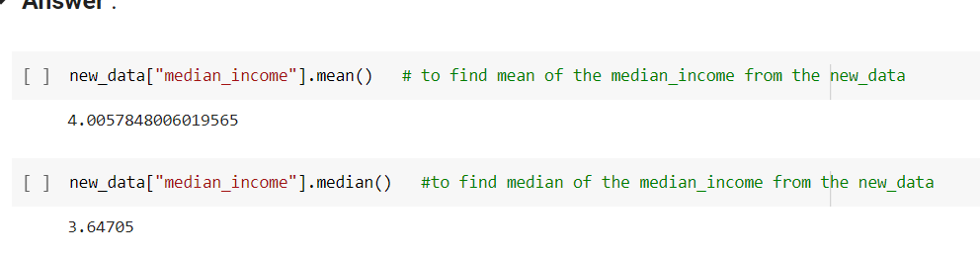
9.Find the mean and median of the median income for the data set created in question 8

Slide 15
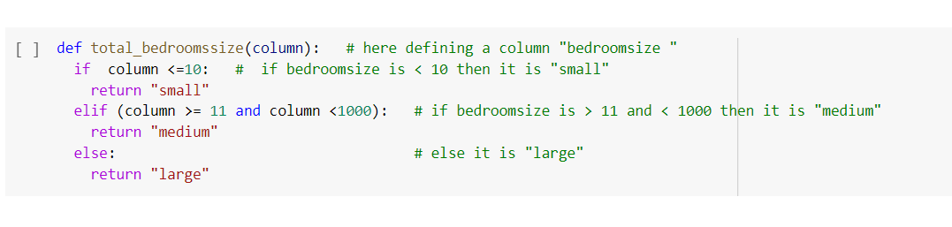
10.Please create a new column named total_bedroom_size.if the size is 10 or less,it should be quoted as small.if the size is 11 or more but less than 1000, it should be medium.otherwise it should be considered large

Slide 16
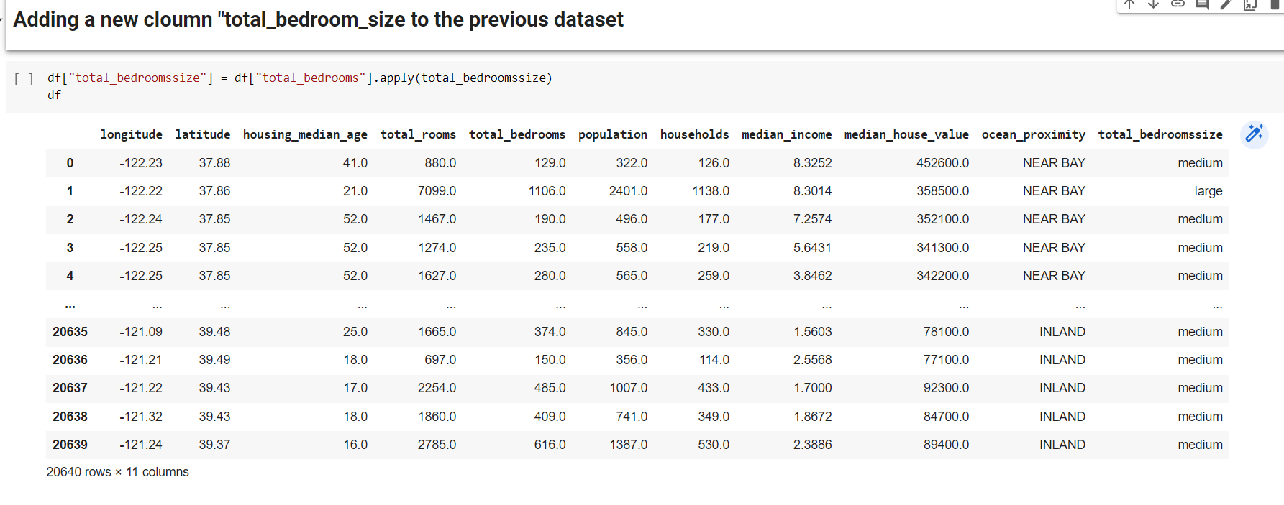
Apply()

Slide 17
THANK YOU

